Slide 1
MARKET PRICE PREDICTION USING TIME SERIES ANALYSIS
NAME: MADIHA SEHAR

Slide 2
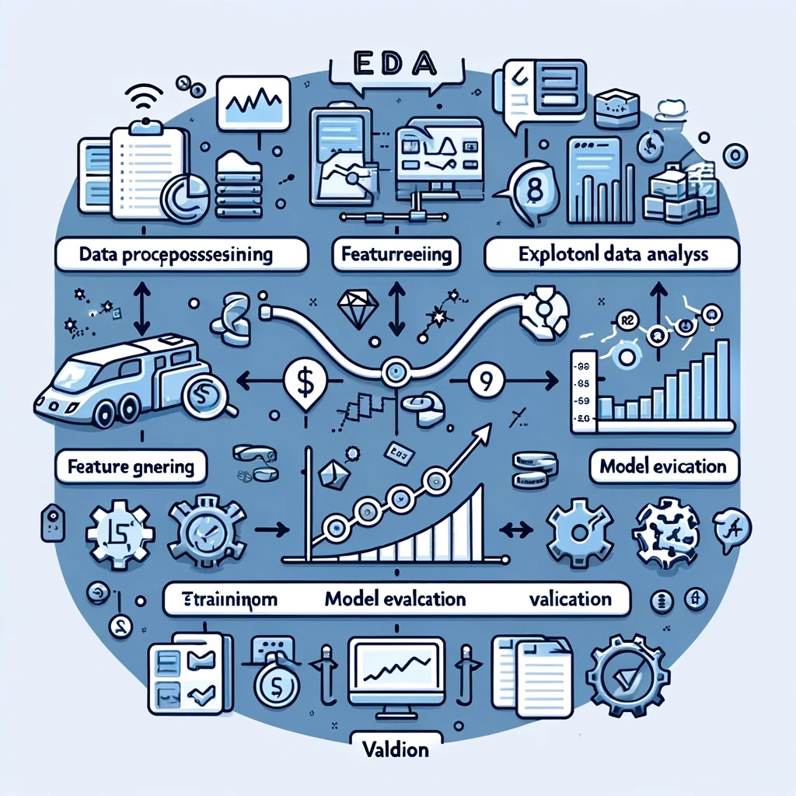
Introduction
Predicting market prices is critical for making educated decisions in finance and economics. The goal of this project is to create an accurate forecasting model for market prices by combining time series analysis and machine learning. The important steps are:
Data preprocessing includes cleaning the dataset, addressing missing values, and encoding categorical variables.
Exploratory Data Analysis (EDA) involves identifying trends, seasonality, and anomalies in data.
Feature engineering involves developing lagged variables, rolling statistics, and seasonal indicators.
Model Selection and Training: Evaluate models such as ARIMA, SARIMA, Prophet, and LSTM and train the best one.
Model evaluation involves assessing performance using measures such as MAE, MSE, and RMSE.
Fine-tuning and validation entails optimizing model parameters and testing them on previously unseen data.

Slide 3
Data Description:
The dataset comprises the following columns:
• Market: The market or commodity under consideration.
• Month: The month for which the data is recorded.
• Year: The year corresponding to the recorded data.
• Quantity: The quantity of the commodity traded or available.
• PriceMin: The minimum price of the commodity during the month.
• PriceMax: The maximum price of the commodity during the month.
• PriceMod: The mode or most frequently occurring price of the commodity during the month.
• State: The state or region where the market is located.
• City: The city where the market is situated.
• Date: The specific date of the recorded data.

Slide 8
Outcome
Despite painstaking efforts, the ARMA model performed poorly, with a significant root-mean-squared error (RMSE) for both quantity and price predictions. Unfortunately, it failed to adequately capture the subtle patterns in the dataset, exposing severe flaws in its forecasting ability.
The SARIMAX model performed marginally better than ARMA, but its forecast accuracy fell short of expectations. Although it exhibited a small increase, it is evident that significant improvements are required to get acceptable outcomes.
Overall, the models had mixed results, correctly predicting some values but incorrectly anticipating others. This highlights the importance of continual modification and optimization to improve model efficacy.
Looking ahead, there is a clear mandate to devote additional resources to enhance the model's performance. We hope to improve predicted accuracy and reliability by fine-tuning parameters, investigating new features, and refining algorithms.

